Slide 1
Unit 1
ITPM CSBS Sem VIII

Slide 2
Project Identification
The purpose of project identification is to develop a preliminary proposal for the most appropriate set of interventions and course of action, within specific time and budget .
Identification involves:
a review of alternative approaches or options for addressing a set of development problems and opportunities;
the definition of project objectives and scope of work at the degree of detail necessary to justify commitment of the resources for detailed formulation and respective preparatory studies; and
the identification of the major issues that must be tackled and the questions to be addressed before a project based on the concept can be implemented.

Slide 3
Market and demand analysis
Market and demand analysis are carried out by the project manager in the process of evaluating a project idea
Six steps :
situational analysis and objectives specification,
collection of data,
market survey,
market description,
demand forecasting
market planning.

Slide 4
Market and demand analysis
1. situational analysis and objectives specification :
In order to get a “feel” of the relationship between the product and its market, the project analyst may informally talk to customers, competitors, middlemen, and others in the industry.
2. collection of data
partly from secondary sources and partly through a market survey
For secondary sources reliability, accuracy, and relevance for the purpose under consideration must be carefully examined

Slide 5
Market and demand analysis
The market analyst should seek to know:
Who gathered the information? What was the objective?
When was the information gathered? When was it published?
How representative was the period for which the information was gathered?
Have the terms in the study been carefully and unambiguously defined?
What was the target population?
How was the sample chosen?
How representative was the sample?
How satisfactory was the process of information gathering?
What was the degree of sampling bias and non-response bias in the information gathered?
What was the degree of misrepresentation by respondents?

Slide 6
Market and demand analysis
3. Conduct of market survey:
For getting primary and secondary information market survey is needed to be done the market survey may be a census survey or a sample survey. In a census survey entire population is covered. On the other hand in a simple survey, a sample of the population is contracted or observed.

Slide 7
Market and demand analysis
4. Market description:
Based on the information gathered from secondary sources and through the market survey, the market for the product or service may be described in terms of the following –
Effective demand in the past and present;
Breakdown of demand,
Price,
Methods of distribution and sales promotion;
Consumers;
Supply and competition;
Government policy.

Slide 8
Market and demand analysis
5. Demand Forecasting :
After gathering information about various aspects of the market and demand from primary and secondary sources, an attempt may be made to estimate future demand. A wide manage of forecasting methods is available to the market analyst.
Uncertainties in demand forecasting: Demand forecasts are subject to error and uncertainty which arise from three principal sources:-
Data about past and present market;
Methods of forecasting;
Environmental change.

Slide 9
Market and demand analysis
6. Market Planning
A market planning usually has the following components.
Current marketing situation;
Opportunity and issue analysis;
Objective;
Marketing strategy;
Action programmed.

Slide 10
Project estimation technique
An estimate is a rough calculation of something.
Key areas that benefit use of project estimating technique:
1. Cost 4. Risk
2. Time 5. Resources
3. Scope 6. Quality

Slide 11
Project estimation technique
Types :
Top-down estimate – Work Breakdown Structure
Bottom-up estimate
Expert judgement
Comparative estimation
Parametric modeling estimation
Three-point estimation

Slide 12
Project cost estimation
Software size estimation :
Essential part of SPM
helps the project manager to further predict the effort and time which will be needed to build the project

Slide 13
Project cost estimation
1. Line of Code
count the total number of lines of source code in a project. The units of LOC are:
KLOC- Thousand lines of code
NLOC- Non-comment lines of code
KDSI- Thousands of delivered source instruction

Slide 14
Project cost estimation
2. Number of entities in ER diagram
ER model provides a static view of the project.
It describes the entities and their relationships.
The number of entities in ER model can be used to measure the estimation of the size of the project.
The number of entities depends on the size of the project.

Slide 15
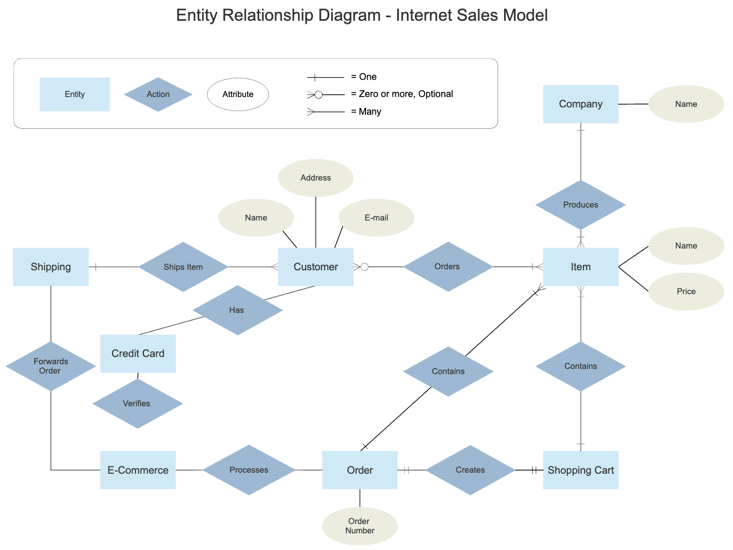

Slide 16
Project cost estimation
3. Total number of processes in detailed data flow diagram:
Data Flow Diagram(DFD) represents the functional view of software.
Already existing processes of similar type are studied and used to estimate the size of the process.

Slide 17
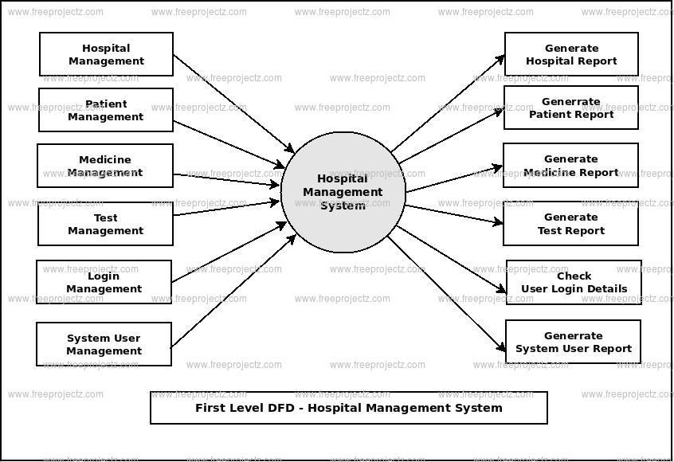

Slide 18
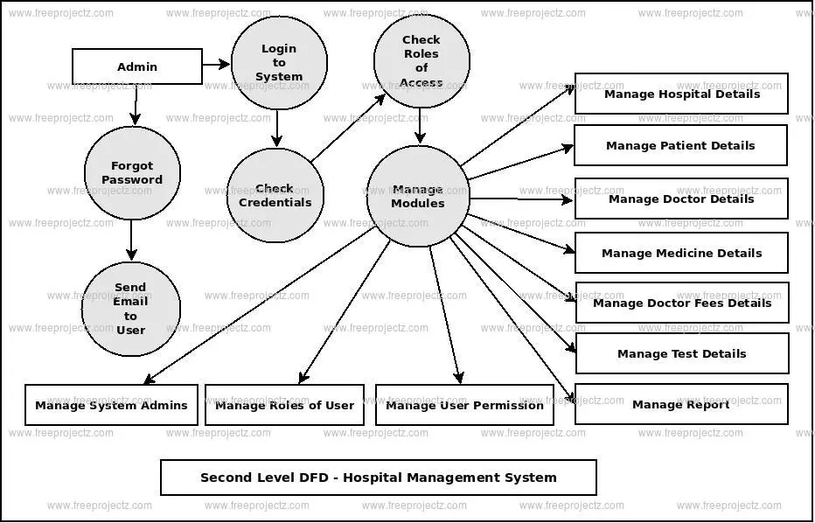

Slide 19
Project cost estimation
4. Function Point Analysis:
The steps in function point analysis are:
Count the number of functions of each proposed type.
Compute the Unadjusted Function Points(UFP).
Find Total Degree of Influence (TDI).
Compute Value Adjustment Factor (VAF).
Find the Function Point Count (FPC).

Slide 20
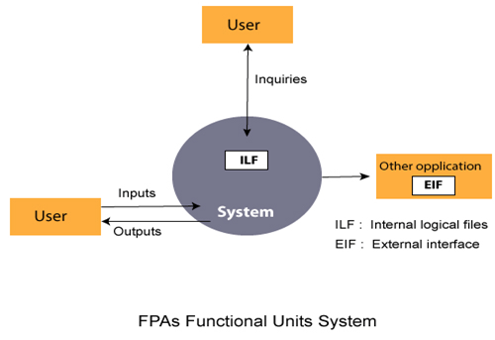

Slide 21
Project cost estimation
Count the number of functions of each proposed type: Find the number of functions belonging to the following types:
External Inputs: Functions related to data entering the system.
External outputs: Functions related to data exiting the system.
External Inquiries: They lead to data retrieval from the system but don’t change the system.
Internal Files: Logical files maintained within the system. Log files are not included here.
External interface Files: These are logical files for other applications which are used by our system.

Slide 22
Project cost estimation
Compute the Unadjusted Function Points(UFP): Categorise each of the five function types like simple, average, or complex based on their complexity. Multiply the count of each function type with its weighting factor and find the weighted sum. The weighting factors for each type based on their complexity are as follows:

Slide 23
Project cost estimation
Example:
Function type | Simple | Average | Complex
External Inputs | 3 | 4 | 6
External Output | 4 | 5 | 7
External Inquiries | 3 | 4 | 6
Internal Logical Files | 7 | 10 | 15
External Interface Files | 5 | 7 | 10

Slide 24
Project cost estimation
Find Total Degree of Influence (TDI) : Use the ’14 general characteristics’ of a system to find the degree of influence of each of them. (0-5 scale)
Data Communications, Distributed Data Processing, Performance, Heavily Used Configuration, Transaction Rate, On-Line Data Entry, End-user Efficiency, Online Update, Complex Processing Reusability, Installation Ease, Operational Ease, Multiple Sites and Facilitate Change.

Slide 25
Project cost estimation
Compute Value Adjustment Factor(VAF): Use the following formula to calculate VAF VAF = (TDI * 0.01) + 0.65

Slide 26
Project cost estimation
Find the Function Point Count: Use the following formula to calculate FPC FPC = UFP * VAF

Slide 27
Project cost estimation
Based on the FP measure of software many other metrics can be computed:
Errors/FP
Function cost = $/FP.
Defects/FP
Pages of documentation/FP
Errors/PM.
Productivity = FP/PM (effort is measured in person-months).
$/Page of Documentation.

Slide 28
Project cost estimation
Example of function point :
Given the following values, compute function point when all complexity adjustment factor (CAF) and weighting factors are average.
User Input = 50
User Output = 40
User Inquiries = 35
User Files = 6
External Interface = 4

Slide 29
Project cost estimation
Step-1: As complexity adjustment factor is average (given in question), hence,scale = 3.
F = 14 * 3 = 42
Step-2:CAF = 0.65 + ( 0.01 * 42 ) = 1.07
Step-3: As weighting factors are also average (given in question) hence we will multiply each individual function point to corresponding values in TABLE.UFP = (50*4) + (40*5) + (35*4) + (6*10) + (4*7) = 628
Step-4:Function Point = 628 * 1.07 = 671.96

Slide 30
Project cost estimation
Calculate the function point, productivity, documentation, and cost per function for software application with multiple Processing Factors 5, 1, 0, 4, 3, 5, 4, 3, 4, 5, 2, 3, 4, 2 by using following given Date: The number of EI(Avg): 22,The number of EO(Low): 45,The number of EI(High): 06, The number of ILF(Avg): 05, The number of ELF(Low): 02, Effort:37 MM, Software technical documents: 250 pages, User related documents: 120 pages and Budgeting/Cost: $7520 per month.

Slide 31
Example of function point
Parameters | Weight Factors
 | Low | Average | High
External Inputs (EI) | 3 | 4 | 6
External Outputs (EO) | 4 | 5 | 7
External Inquiries (EI) | 3 | 4 | 6
Internal Logic Files (ILF) | 7 | 10 | 15
External Logic Files(ELF) | 5 | 7 | 10

Slide 32
Example of function point
Productivity (P) = FP/Effort
Total Page of Documentation (PD) = Software Technical Documents + User related documents
Documentation (D) = PD/FP
Cost of each Functionalities = COST/Productivity

Slide 33
Example of function point
Example: Compute the function point, productivity, documentation, cost per function for the following data:
Number of user inputs = 24 (Average)
Number of user outputs = 46 (Simple)
Number of inquiries = 8 (Complex)
Number of files = 4 (Average)
Number of external interfaces = 2 (Simple)
Effort = 36.9 p-m
Technical documents = 265 pages
User documents = 122 pages
Cost = $7744/ month
Various processing complexity factors are: 4, 1, 0, 3, 3, 5, 4, 4, 3, 3, 2, 2, 4, 5.

Slide 34
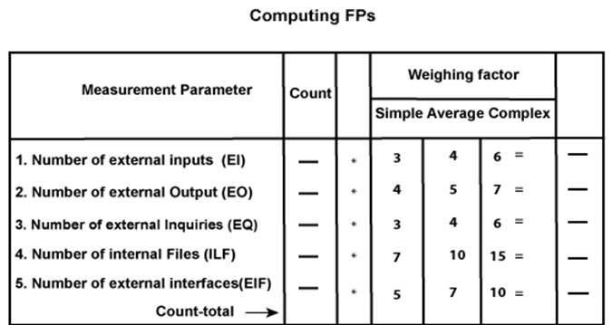

Slide 35
So sum of all fi (i ← 1 to 14) = 4 + 1 + 0 + 3 + 5 + 4 + 4 + 3 + 3 + 2 + 2 + 4 + 5 = 43
FP = Count-total * [0.65 + 0.01 *∑(fi)]
= 378 * [0.65 + 0.01 * 43]
= 378 * [0.65 + 0.43]
= 378 * 1.08 = 408
Functional Point (FP) Analysis
Total pages of documentation = technical document + user document
= 265 + 122 = 387pages
Documentation = Pages of documentation/FP
= 387/408 = 0.94
Functional Point (FP) Analysis

Slide 36
Financial Appraisal
Financial appraisal is a method used to evaluate the viability of a proposed project by assessing the value of net cash flows that result from its implementation.

Slide 37
Financial Appraisal
1. Return on Investment (ROI). ROI is a direct measure of the return of capital produced by a project relative to the amount of capital spent on or invested in a project. ROI is calculated with the following equation:
ROI = (Gain from Investment – Investment Cost) / Investment Cost
The higher the return on investment, the more desirable the project.

Slide 38
ROI examples
A person bought a house that needed significant work for $100,000. During the course of a year, they invested an additional $100,000 to renovate the house to make it sellable. They are able to sell the renovated house for $250,000. Calculate ROI

Slide 39
Financial Appraisal
2. Payback Period :
The payback period of a project examines how long a project will take in order to recover the amount of capital invested. It asks the question; how long will it take for a project to generate enough income to pay for itself? The simplest calculation for payback period is to divide the amount of capital invested in the project by the amount generated (or saved) by the project per period of time (months, years, etc.).
Payback period = amount of capital invested / amount generated per period of time
Using payback period, the project with the shortest time to recover invested capital should be selected.

Slide 40
Financial Appraisal
NPV
Net present value is a tool of Capital budgeting to analyze the profitability of a project or investment. It is calculated by taking the difference between the present value of cash inflows and present value of cash outflows over a period of time
NPV=Cash flow/(1+i)^t ​−initial investment
where:
i=Required return or discount rate
t=Number of time periods​

Slide 41
NPV Example
Company A ltd wanted to know their net present value of cash flow if they invest 100000 today. And their initial investment in the project is 80000 for the 3 years of time, and they are expecting the rate of return is 10 % yearly. From the above available information, calculate the NPV.

Slide 42
NPV example
NPV = Cash flows /(1- i)t – Initial investment
= 100000/(1-10)^3-80000
NPV = 57174.21

Slide 43
Financial Appraisal
Advantage of NPV :
Better approach as it considers time value for money
Gives importance to profitability and risk
Helps in maximizing value of the company
Considers changing discount rate
Disadvantage:
Complex to calculate
Sensitive to fluctuations
Fails to provide accurate result when the two projects have different life period

Slide 44
Financial Appraisal
IRR :
NPV=t=0∑n CFt​​ / ​(1+r)t​​
where:CFt​=net after-tax cash inflow-outflows during a single period t
r=internal rate of return that could be earned in alternative investments
t=time period cash flow is received
n=number of individual cash flows​

Slide 45
Financial Appraisal
Advantage of IRR:
Considers time value of money
Considers cash flows thru the life span
Consistent vth wealth maximization objective
Disadvantage:
Tedius and difficult calculation
Produces multiple rate of return
May not give valid result for unequal project span, unequal cash flow

Slide 46
Financial Appraisal
The Cost Performance Index (CPI) is a method for calculating the cost efficiency and financial effectiveness of a specific project through the following formula:
CPI = earned value (EV) / actual cost (AC).
A CPI ratio with a value higher than 1 indicates that a project is performing well budget-wise

Slide 47
Financial Appraisal
Accounting Rate of Return (ARR) is the percentage rate of return that is expected from an investment or asset compared to the initial cost of investment. Typically, ARR is used to make capital budgeting decisions. For example, if your business needs to decide whether to continue with a particular investment, whether it’s a project or an acquisition, an ARR calculation can help to determine whether going ahead is the right move.
The Accounting Rate of Return formula is as follows:
ARR = average annual profit / average investment

Slide 48
Financial Appraisal
Example
A Company wants to invest in new set of vehicles for the business. The vehicles cost 350,000 and would increase the company’s annual revenue by 100,000, as well as the company’s annual expenses by 10,000. The vehicles are estimated to have a useful shelf life of 20 years, with no salvage value. So, the ARR calculation is as follows:
Average annual profit = 100,000 - 10,000 = 90,000
Depreciation expense = 350,000 / 20 = 17,500
True average annual profit = 90,000 - 17,500 = 72,500
ARR = 72,500 / 350,000 = 0.2071 = 20.71%

Slide 49
ARR example
XYZ Company is looking to invest in some new machinery to replace its current malfunctioning one. The new machine, which costs $420,000, would increase annual revenue by $200,000 and annual expenses by $50,000. The machine is estimated to have a useful life of 12 years and zero salvage value.

Slide 50
ARR example
Calculate Average Annual Profit
inflows, Years 1-12 = (200,000*12) = 2400000
Annual Expenses
(50,000*12) = 600000
Depreciation
420,000
Total profit : 1380000
Average Annual Profit
(1,380,000/12) = 115,000

Slide 51
ARR example
Calculate Average Investment
($420,000 + $0)/2 = $210,000
Use ARR Formula
ARR = $115,000/$210,000 = 54.76%

Slide 52
ARR example
2. XYZ Company is considering investing in a project that requires an initial investment of $100,000 for some machinery. There will be net inflows of $20,000 for the first two years, $10,000 in years three and four, and $30,000 in year five. Finally, the machine has a salvage value of $25,000.
Calculate Average Annual Profit
Inflows, Years 1 & 2
(20,000*2) = 40,000
Inflows, Years 3 & 4
(10,000*2) = 20,000

Slide 53
ARR example
Inflow, Year 5 - 30,000
Depreciation
(100,000-25,000) - 75,000
Total Profit - 15,000
Average Annual Profit
(15,000/5) - 3,000
Calculate Average Investment
($100,000 + $25,000) / 2 = $62,500
Use ARR Formula
ARR = $3,000/$62,500 = 4.8%

Slide 54
Financial Appraisal
What is Break Even Analysis?
Break Even Analysis in economics, business, and cost accounting refers to the point in which total cost and total revenue are equal. A break even point analysis is used to determine the number of units or dollars of revenue needed to cover total costs
Break even quantity = Fixed costs / (Sales price per unit – Variable cost per unit)
Where:
Fixed costs are costs that do not change with varying output (e.g., salary, rent, building machinery).
Sales price per unit is the selling price (unit selling price) per unit.
Variable cost per unit is the variable costs incurred to create a unit.

Slide 55
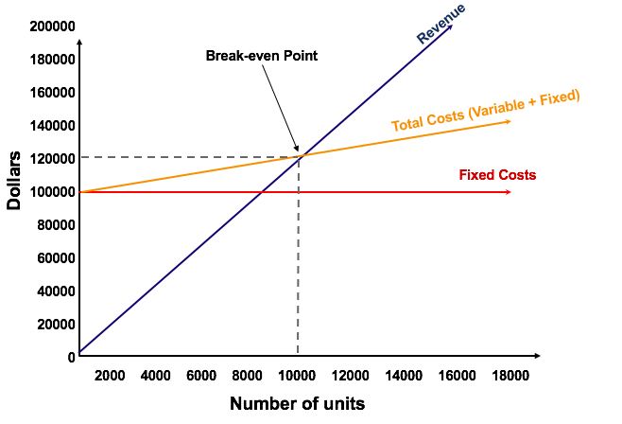
Financial Appraisal

Slide 56
Financial Appraisal
Example of Break Even Analysis
Colin is the managerial accountant in charge of Company A, which sells water bottles. He previously determined that the fixed costs of Company A consist of property taxes, a lease, and executive salaries, which add up to $100,000. The variable cost associated with producing one water bottle is $2 per unit. The water bottle is sold at a premium price of $12. To determine the break even point of Company A’s premium water bottle:
Break even quantity = $100,000 / ($12 – $2) = 10,000
Therefore, given the fixed costs, variable costs, and selling price of the water bottles, Company A would need to sell 10,000 units of water bottles to break even.

Slide 57
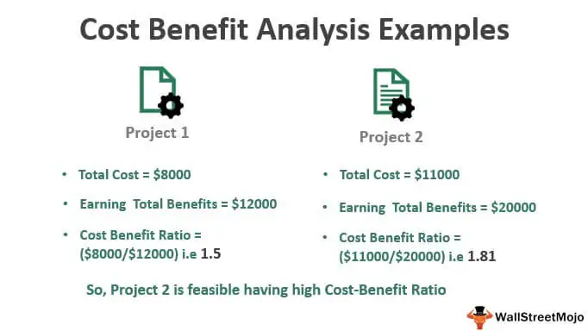
Financial Appraisal

